Slide 1

CSE 260 Digital Logic Design
Text Books:
Core Texts:
Digital Logic And Computer Design, Morris Mano
Reference material:
Digital Design Principles and Practices, John F. Wakerly

Slide 2
CSE 260 Digital Logic Design
Number System & Calculations

Slide 3

Objective | Analog vs. Digital
Distinguish between analog and digital system Understand the advantage and limitation of digital system Understand the meaning of digital logic | Analog data can vary over a continuous range of values. Example: speedometer Digital quantities can take on only discrete values (0 and 1, high and low). Example: Digital Computer, Decimal Digits, Alphabets

Slide 4
Digital System
A digital system is a combination of devices designed to manipulate physical quantities or information that are represented in digital form.
“A discreet information processing system”
Signals: Discreet information

Slide 5
Digital Technology
Advantage | Limitation
Greater accuracy or precision Easier to design (generality) Easier information storage Programmability (instructions) Speed Economical | The real world is mainly analog
 | How to Overcome
 | Convert the real world analog input data into digital one Process this digital data Then again convert into analog form

Slide 6
Digital logic
Design logic is a term used to denote the design and analysis of digital system
Digital logic is concerned with the interconnection among digital components and modules
Digital logic design is engineering and engineering means problem solving

Slide 7

Number systems and codes
Digital Systems are built from circuits that process binary digits. BUT very few real-life problems are based on binary numbers.
SO a digital system designer must establish some correspondence between the binary digits processed by digital circuits and real-life numbers, events and conditions.

Slide 8
Information representation
Human decisions tends to be binary i.e. Yes or No
Elementary storage units inside computer are electronic switches. Each switch holds one of two states: on (1) or off (0).
We use a bit (binary digit), 0 or 1, to represent the state.
Storage units can be grouped together to cater for larger range of numbers. Example: 2 switches to represent 4 values.
ON
OFF
0 (00)
1 (01)
2 (10)
3 (11)

Slide 9
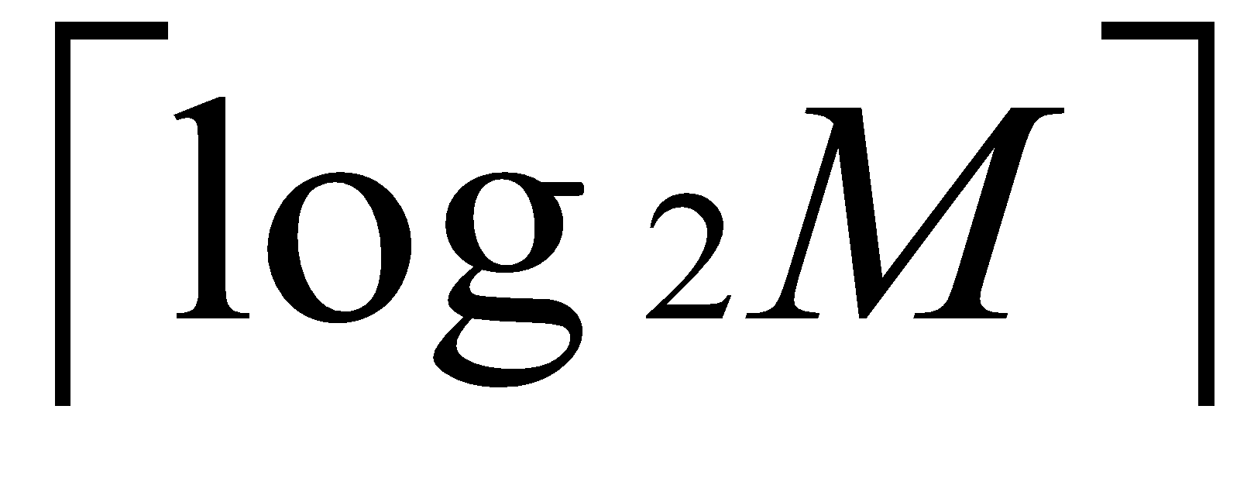
Information representation
In general, N bits can represent 2^{N} different values.
For M values, bits are needed.
1 bit → represents up to 2 values (0 or 1)
2 bits → rep. up to 4 values (00, 01, 10 or 11)
3 bits → rep. up to 8 values (000, 001, 010. …, 110, 111)
4 bits → rep. up to 16 values (0000, 0001, 0010, …, 1111)
32 values → requires 5 bits
64 values → requires 6 bits
1024 values → requires 10 bits
40 values → requires 6 bits
100 values → requires 7 bits

Slide 10
Positional Notations
Decimal number system, symbols = { 0, 1, 2, 3, …, 9 }
Position is important
Example:(7594)₁₀ = (7x10³) + (5x10²) + (9x10¹) + (4x10⁰)
In general, (a_{n}a_{n-1}… a₀)₁₀ = (a_{n} x 10^{n}) + (a_{n-1} x 10^{n-1}) + … + (a₀ x 10⁰)
(2.75)₁₀ = (2 x 10⁰) + (7 x 10⁻¹) + (5 x 10⁻²)
In general, (a_{n}a_{n-1}… a₀ . f₁f₂ … f_{m})₁₀ = (a_{n} x 10^{n}) + (a_{n-1}x10^{n-1}) + … + (a₀ x 10⁰) + (f₁ x 10⁻¹) + (f₂ x 10⁻²) + … + (f_{m} x 10^{-m})

Slide 11
Other Number Systems
Binary (base 2): weights in powers-of-2. Binary digits (bits): 0,1.
Octal (base 8): weights in powers-of-8. Octal digits: 0,1,2,3,4,5,6,7
Hexadecimal (base 16): weights in powers-of-16. Hexadecimal digits: 0,1,2,3,4,5,6,7,8,9,A,B,C,D,E,F
Note: when base is r, coefficient values range from 0 to r-1.

Slide 12
Other Number System
Binary (base 2): weights in powers-of-2. Binary digits (bits): 0,1.
Octal (base 8): weights in powers-of-8. Octal digits: 0,1,2,3,4,5,6,7
Hexadecimal (base 16): weights in powers-of-16. Hexadecimal digits: 0,1,2,3,4,5,6,7,8,9,A,B,C,D,E,F
Binary | Octal | Decimal | Hexadecimal
0000 | 0 | 0 | 0
0001 | 1 | 1 | 1
0010 | 2 | 2 | 2
0011 | 3 | 3 | 3
0100 | 4 | 4 | 4
0101 | 5 | 5 | 5
0110 | 6 | 6 | 6
0111 | 7 | 7 | 7
1000 | 10 | 8 | 8
1001 | 11 | 9 | 9
1010 | 12 | 10 | A
1011 | 13 | 11 | B
1100 | 14 | 12 | C
1101 | 15 | 13 | D
1110 | 16 | 14 | E
1111 | 17 | 15 | F
Notes:
Farazul H Bhuiyan
Lecturer
Dept. of CSE
BRAC University
Bangladesh
‹#›

Slide 13
Base-R to Decimal Conversion
***Formula= ∑ digit * source_base ^{position}
(1101.101)₂ = 1×2³ + 1×2² + 1×2⁰ + 1×2⁻¹ + 1×2⁻³ = 8 + 4 + 1 + 0.5 + 0.125
= (13.625)₁₀
(572.6)₈ = 5×8² + 7×8¹ + 2×8⁰ + 6×8⁻¹ = 320 + 56 + 2 + 0.75 = (378.75)₁₀
(2A.8)₁₆ = 2×16¹ + 10×16⁰ + 8×16⁻¹ = 32 + 10 + 0.5 = (42.5)₁₀
(341.24)₅ = 3×5² + 4×5¹ + 1×5⁰ + 2×5⁻¹ + 4×5⁻² = 75 + 20 + 1 + 0.4 + 0.16 = (96.56)₁₀

Slide 14
Decimal to Base-R Conversion
Decimal to base-R
Whole numbers: repeated division-by-R
Fractions: repeated multiplication-by-R

Slide 15
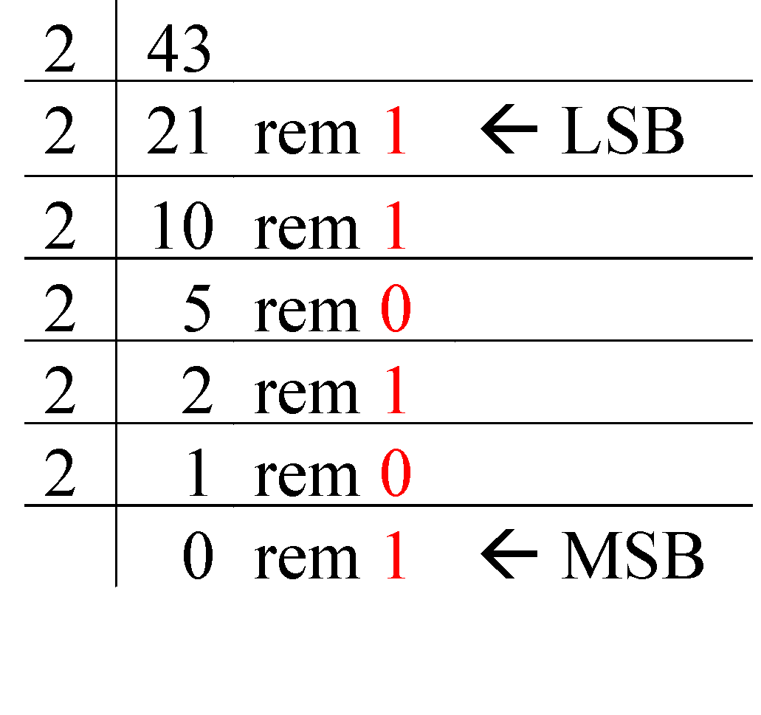
Repeated Division-by-2 Method
To convert a whole number to binary, use successive division by 2 until the quotient is 0. The remainders form the answer, with the first remainder as the least significant bit (LSB) and the last as the most significant bit (MSB).
(43)₁₀ = (101011)₂

Slide 16
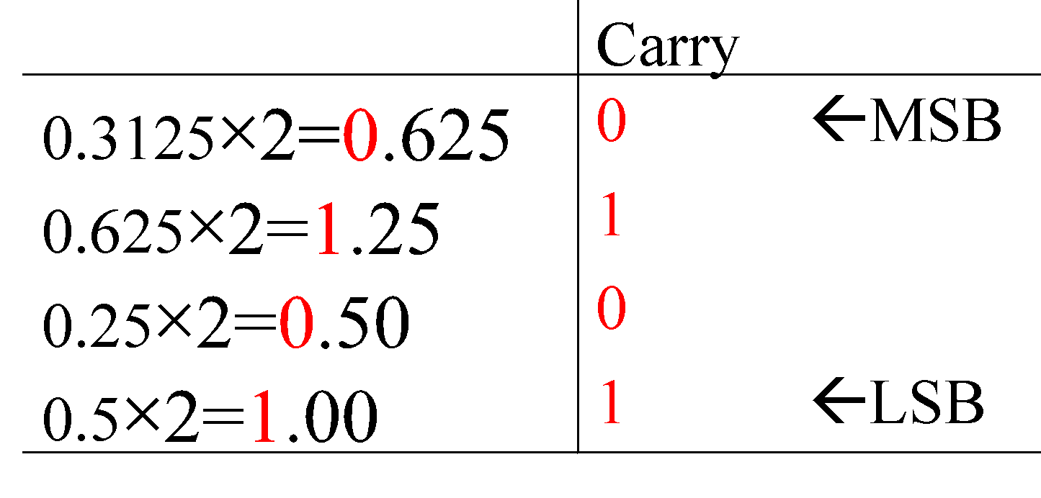
Repeated Multiplication-by-2 Method
To convert decimal fractions to binary, repeated multiplication by 2 is used, until the fractional product is 0 (or until the desired number of decimal places). The carried digits, or carries, produce the answer, with the first carry as the MSB, and the last as the LSB.
(0.3125)₁₀ = (.0101)₂

Slide 17
Note: difference between conversion of integer and fraction
Integer
Fraction
Division by base of target no. system
Remainders are accumulated
By division we obtain LSB to MSB
Multiplication by base of target no. system
Integers are accumulated
By multiplication we obtain MSB to LSB

Slide 18
Binary-Octal/Hexadecimal Conversion
Binary → Octal: Partition in groups of 3
(10 111 011 001 . 101 110)₂ = (2731.56)₈
Octal → Binary: reverse
(2731.56)₈ = (10 111 011 001 . 101 110)₂
Binary → Hexadecimal: Partition in groups of 4
(101 1101 1001 . 1011 1000)₂ = (5D9.B8)₁₆
Hexadecimal → Binary: reverse
(5D9.B8)₁₆ = (101 1101 1001 . 1011 1000)₂

Slide 19
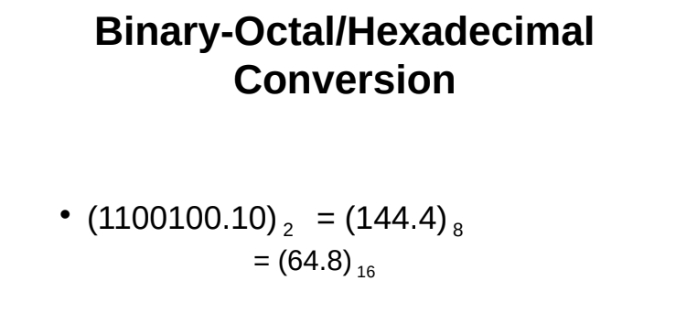

Slide 20
Exercise:
(1)Try converting this to
(10110001101011.111100000110)₂
octal b) hexadecimal
(2) Try converting these to binary
a) (673.124)₈
b) (306.D)₁₆
Answers:
a) (26153.7406)₈
(1) b) (2C6B.F06)₁₆ _{(2) a)} (110 111 011 . 001 010 100)₂ _{(2) b)} (0011 0000 0110 . 1101)₂

Slide 21
Binary operations: Addition: Addition Rules w/Carries
For 2 bit
For 3 bit
0 + 0 = 0 0 ( 0 with a 0 carry )
0 + 1 = 0 1 ( 1 with a 0 carry )
1 + 0 = 0 1 ( 1 with a 0 carry )
1 + 1 = 1 0 ( 0 with a 1 carry )
0+0+0 = 0 0 (0 WITH 0 CARRY)
0+0+1 = 0 1 (1 WITH 0 CARRY)
0+1+1 = 1 0 (0 WITH 1 CARRY)
1+1+1 = 1 1 (1 WITH 1 CARRY)

Slide 22
Adding Binary Numbers
0
1
1
1
0
0
0
28
+ 43
71
⎯→ 00011100
⎯→ + 00101011
0
1
0
0
0
1
1
1
‹#›

Slide 23
Exercise
3(a) Add (101101) ₂ with (100111) ₂
Solution
3(a) (1010100) ₂
_{Working:}
Augend: 101101
Addend: +100111
Sum: 1010100

Slide 24
Addition of base-r
Example: (34)₅+ (41)₅+ (24)₅ 21 (34)₅ (41)₅ + (24)₅ ________________ (2 0 4)₅
4+1+4= 9 9%5=4 9/5=1 (carry)
1+3+4+2= 10 10%5=0 10/5=2 (carry)

Slide 25
Exercise
Try: 2 (a) (FF)₁₆+(F1)₁₆ 2 (b) (66)₇ + (55)₇
Solution
2(a) (1F0) ₁₆
2(b) (154) ₇

Slide 26
Binary Multiplication
The multiplication of two binary numbers can be carried out in the same manner as the decimal multiplication.
Unlike decimal multiplication, only two values are generated as the outcome of multiplying the multiplication bit by 0 or 1 in the binary multiplication. These values are either 0 or 1.
The binary multiplication can also be considered as repeated binary addition. Therefore, the binary multiplication is performed in conjunction with the binary addition operation.

Slide 27
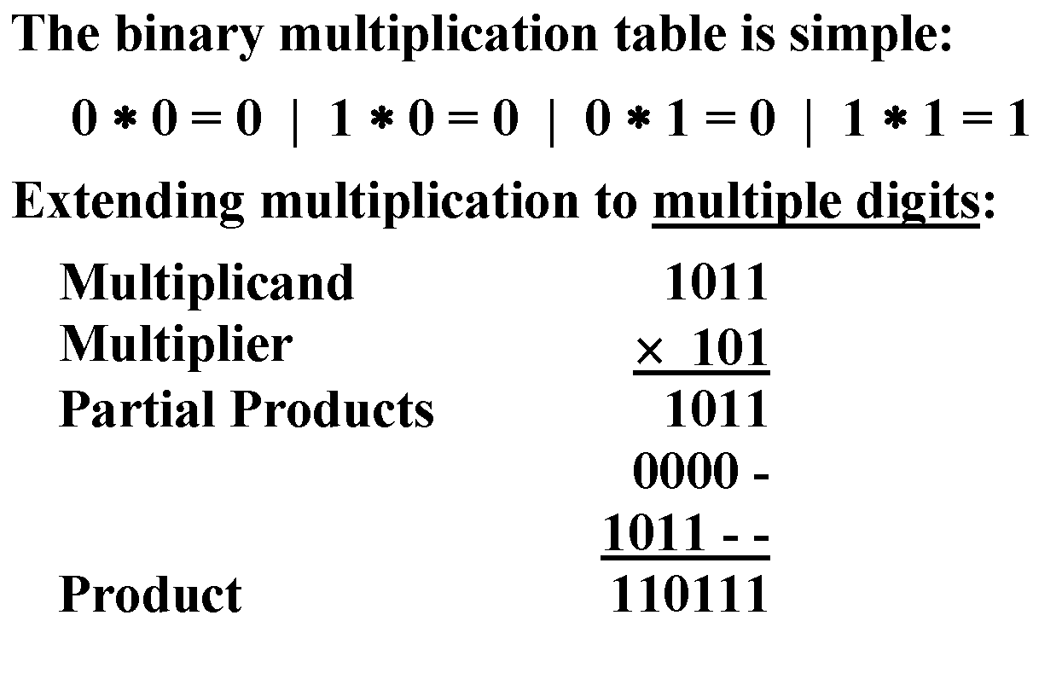
Exercise
6 (a) Multiply 1011 with 101

Slide 28
Multiplication with base-r
Working
2A3C xB7 ------------ 127A4 1D094 ------------ 1E30E4
7*C = 7*12 = 84 =(write 4, carry 5) 7*3+5 = 26 = 1A (write A, carry 1) 7*A+1 = 71 = 0x47 (write 7, carry 4) 7*2+4 = 18 = 0x12 This completes the 7*2A3C = 127A4 partial product. B*C = 11*12 = 132 = (write 4, carry 8) B*3+8 = 11*3+8 = 41 = (write 9, carry 2) B*A+2 = 11*10+2 = 112 = (write 0, carry 7) B*2+7 = 11*2+7 = 29 = 1D This completes the B[0]*2A3C = 1D094[0] partial product, where I'm noting the [0] digits to remind us this is in the 16s column. Adding the partial products: 127A4 + 1D0940 4+0 = 4 A+4 = E 7+9 = 16 = 0x10 (write 0, carry 1) 2+0+1 = 3 1+D = E 1 = 1

Slide 29
Exercise
7 (a) Multiply (34)5 with (42)5
7 (b) Multiply (25)9 with (36)9
Solution
7 (a) (3133)5
7 (b) (1033)9

Slide 30
Binary operations: Subtraction Rules w/Carries
For 2 bit
0 - 0 = 0 0 ( 0 with a 0 carry )
1 - 1 = 0 0 ( 0 with a 0 carry )
1 - 0 = 0 1 ( 1 with a 0 carry )
0 - 1 = ? ( ???)

Slide 31
Subtracting Binary Numbers:
2
0
2
- 1
1
⎯→ 10
⎯→ - 01
0
1
4
- 1
3
⎯→ 100
⎯→ - 001
0
1
1
‹#›

Slide 32
Exercise
5(b) Subtract (100111) ₂ from (101101) ₂
Solution
5 (b) (000110) ₂
_{Working:}
5(b)Subtraction
Minuend: 101101
Subtrahend: −100111
Difference: 000110

Slide 33
Subtraction of Base-r
₃ ₁₆ (4 A 6)₁₆
-(1 B 3)₁₆ ______ (2 F 3)₁₆
4 6 (54)₆ - (35)₆ _____________ (15)₆

Slide 34
Exercise
4 (a) (71)₈-(56)₈
4(b) (21)₃-(12)₃
Solution
4 a) (13)₈
4 b) (2)₃

Slide 35
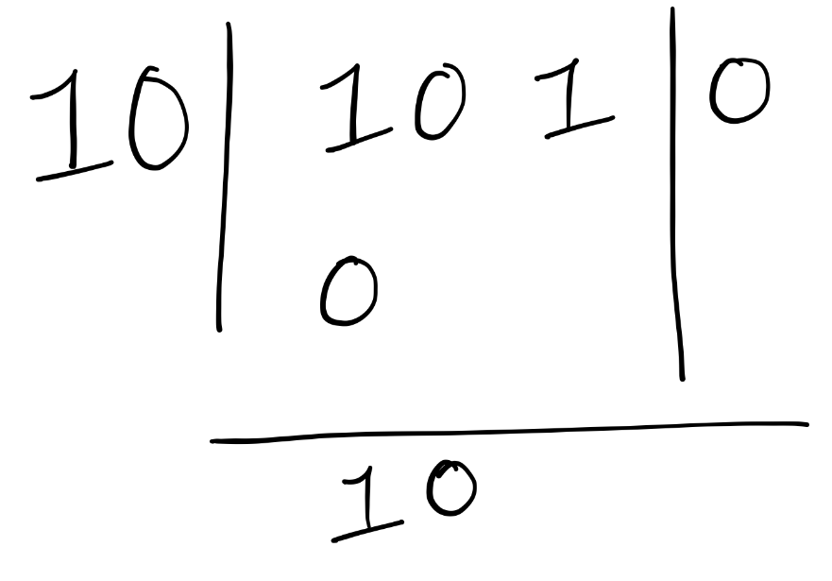
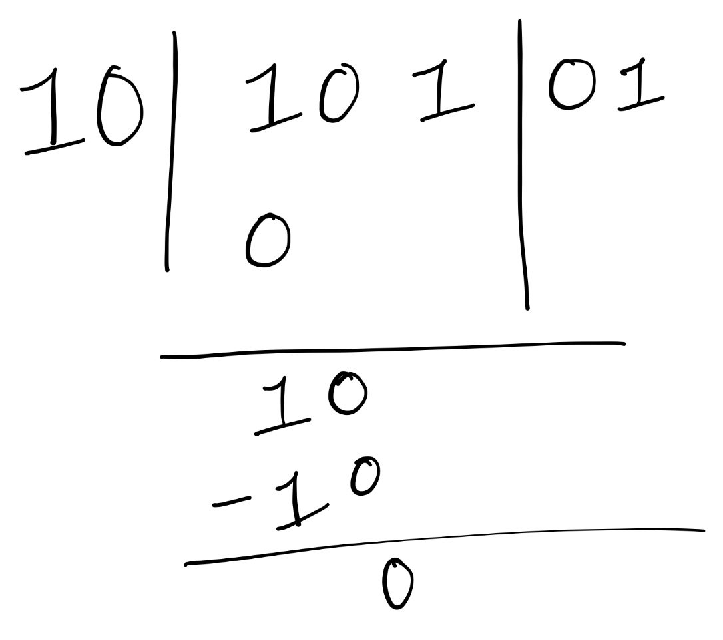
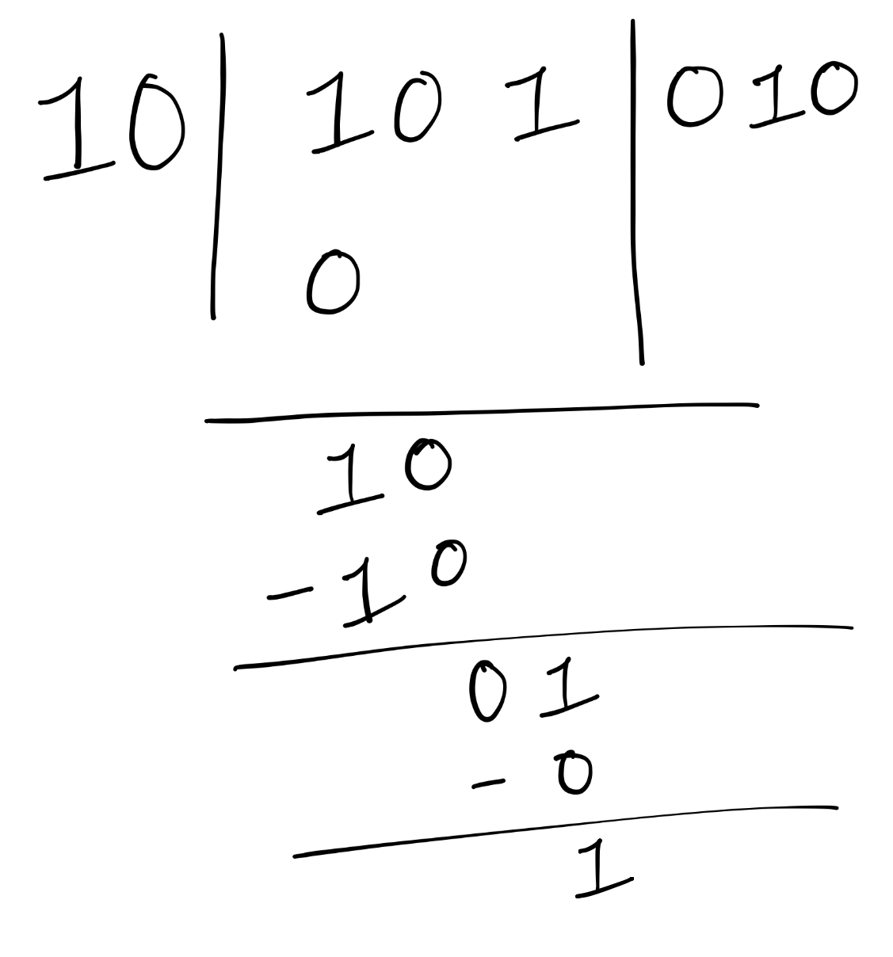
Division of Base-r
Iteration-1: (1 < 10)
Dividend: x₁x₂x₃...x_{m}; Divisor: y₁y₂...y_{n} = y;
Perform 101₂ / 10₂; Dividend = 101 and Divisor = 10
Step1: Start with the first digit of the dividend. (x₁)
Step2: Compare it with the divisor;
If (it is smaller, than the divisor): (x₁<y)
2.a append 0 to the quotient.
else: (x₁ >= y) proceed with division.
2.a Find the largest multiple of the divisor that fits.
2.b Append the multiplier to the quotient.
Step3: Subtract and bring down the next digit.
Step4: From now on compare the newly formed number
in step3 with the divisor while repeating step2.
Step5. Repeat this step 2, 3 & 4 until all digits of the dividend
(x₁x₂x₃...x_{m}) are processed.
Iteration-2: (10 == 10)
Iteration-3: (01 < 10)

Slide 36
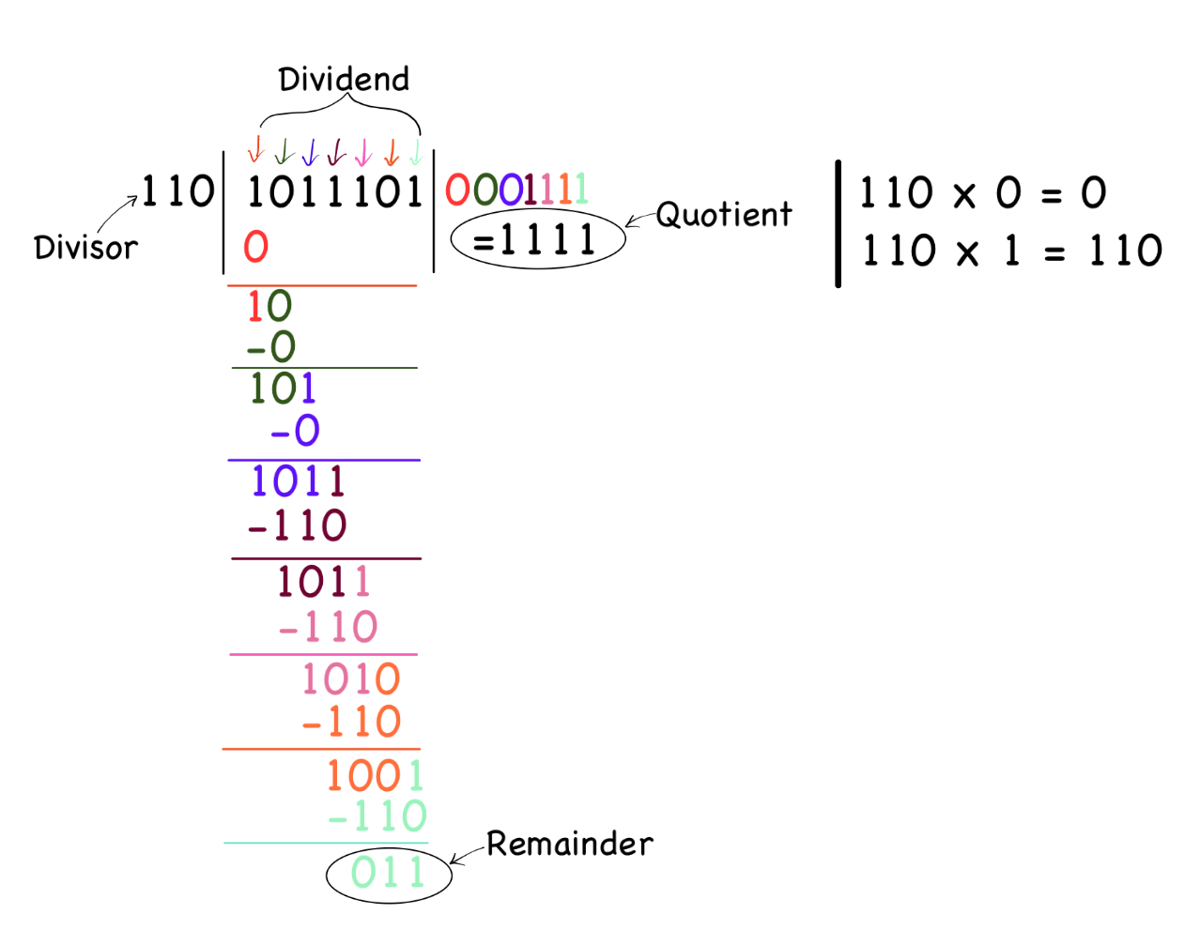
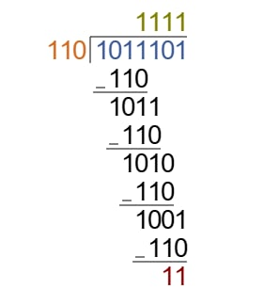
Example - 1
Perform 1011101₂ / 110₂; Find the quotient and remainder.

Slide 37
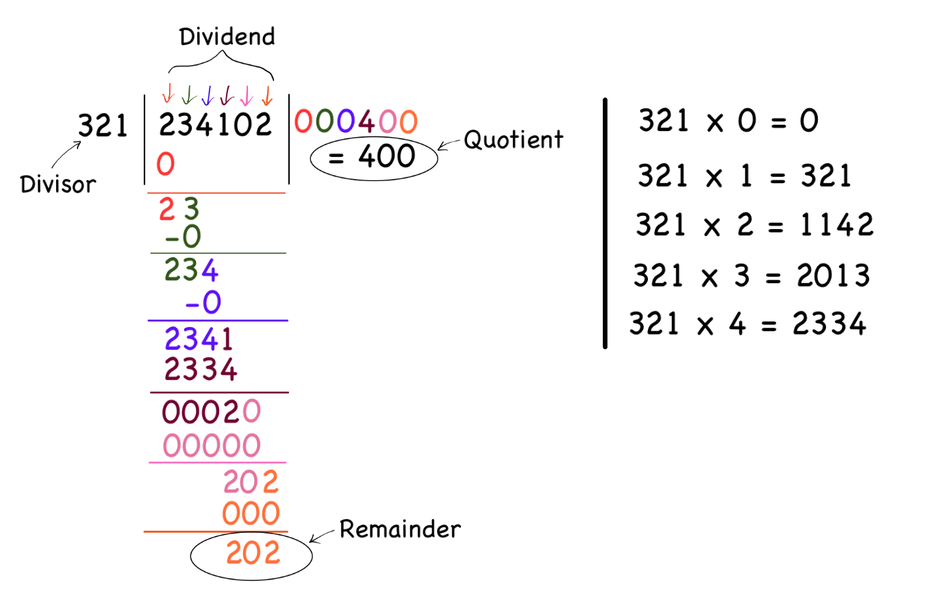
Example - 2
Perform 234102₅ / 321₅; Find the quotient and remainder.

Slide 38
Exercise
4 (a) (71)₈/ (56)₈
4(b) (21)₃/ (12)₃
Solution
4 a) Quotient = ()₈, Remainder = ()₈
4 b) Quotient = ()₃, Remainder = ()₃

